Slide 1

SRM INSTITUTE OF SCIENCE AND TECHNOLOGY
SCHOOL OF COMPUTING
DEPARTMENT OF COMPUTER SCIENCE AND
ENGINEERING
18CSP109L– MAJOR PROJECT FACE RECOGNITION BASED ATTENDANCE SYSTEM
Batch ID: 24MP27030007
AHSAN SULTAN (RA2011027030007)
AKSHIT PARMAR (RA2011027030006)
DEVANSH TOMAR (RA2011027030017)
Guide name: DR PRIYANKA GUPTA
Designation: Assistant Professor
Department: CSE

Slide 2
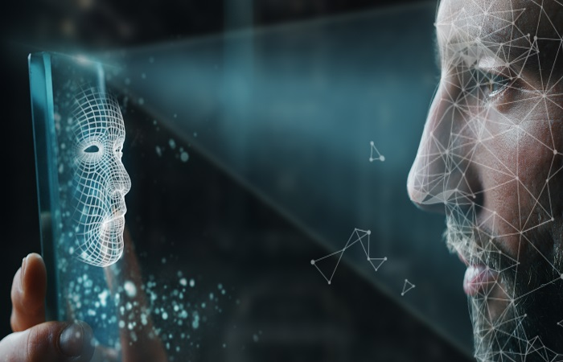
CONTENTS
ABSTRACT - 1
INTRODUCTION – 2
LITERATURE SURVEY 3 - 10
PROBLEM STATEMENT AND OBJECTIVES 11 - 12
EXISTING PROBLEM – 13
PROPOSED SOLUTION - 14
METHODOLOGY - 15
BLOCK DIAGRAM – 16
1

Slide 3
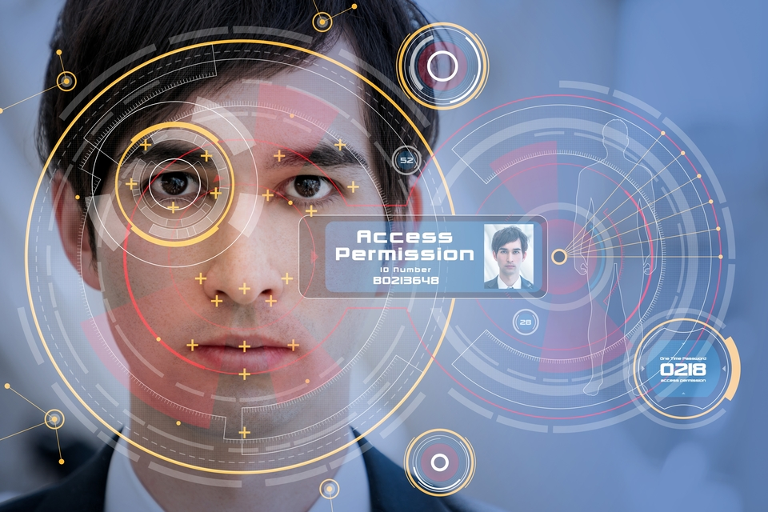
CONTENTS
Intermediate Code 17 – 19
References 20 - 22

Slide 4
ABSTRACT
Facial recognition technology has gained significant attention in recent years due to its potential applications in various fields, including attendance systems.
This system aims to provide a reliable, efficient, and contactless solution for attendance marking, especially in the context of the COVID-19 pandemic. By leveraging deep learning algorithms and computer vision techniques, the proposed system can detect and recognize faces with high accuracy, even when individuals wear masks or their faces are partially included.
The system consists of two main components: face detection and face recognition. The face detection module utilizes the Multi-Task Cascaded Convolutional Networks (MTCNN) algorithm to identify and extract facial landmarks, enabling the system to detect faces in images and videos accurately.
1

Slide 5
introduction
In this attendance system, we will use a combination of face recognition and deep learning algorithms to achieve accurate and reliable attendance marking. The system will be designed to work in real-time, allowing it to detect and recognize faces in images and videos.
To ensure the system's robustness and reliability, we will implement several data augmentation techniques, such as rotation, scaling, and brightness adjustments. These techniques will help the model generalize better to various lighting conditions and orientations.
The system will be implemented using Python and the OpenCV library. We will utilize the Dlib library for face detection and recognition, and the FaceNet CNN model for feature extraction.
2

Slide 6
Literature Survey
Author | Year | Approach | Abstract | Pros | Cons
N. Kar M. K. Debbarma A. Saha D. R. Pal | 2012 | Implementation of an automated attendance system using face recognition technology. | Introduced an automated attendance management system using facial recognition with Principal Component Analysis. The system utilized OpenCV for image processing and facial recognition, and FLTK for user interface design. It aimed to streamline attendance tracking by matching facial features and updating the database seamlessly. | Utilization of face recognition technique with Principal Component Analysis (PCA) for attendance management, Integration of OpenCV and FLTK libraries Streamlining of attendance tracking process through leveraging facial recognition technology | Encounter challenges in certain conditions such as poor lighting, varying facial expressions, or occlusions. The use of facial recognition technology raises privacy concerns, as it involves the collection and processing of biometric data.
Marko Arsenovic Srdjan Sladojevic Andras Anderla Darko Stefanovic | 2015 | The development of a face recognition attendance system based on deep learning techniques. | It identifies lighting variations as influential factors affecting recognition, proposing gradient transformation as a potential solution. Additionally, the abstract suggests periodic re-training of the deep CNN with newly gathered images to continually enhance system accuracy. | Improved accuracy in recognizing faces, even with a limited dataset. The system identifies and addresses challenges such as variations in lighting conditions, transformation as a potential solution | The effectiveness of the system heavily relies on the quality and diversity of the training data. Limited or biased datasets may lead to inaccuracies or biases in recognition.
3

Slide 7
Literature Survey
Author | Year | Approach | Abstract | Pros | Cons
Mayank Srivastava Amit Kumar Aditya Dixit Aman Kumar | 2020 | The development of a real-time attendance system using face recognition techniques. | A facial recognition system was evaluated using a training set of 30 faces from 7 individuals, Employing the "Extract()" function to generate binary images. Results suggest a decrease in detection and recognition rates with increased face angles, prompting the proposal of a facial recognition-based attendance management system for colleges. | The system leverages facial recognition techniques to accurately identify individuals The system provides real-time attendance data, enabling timely intervention and management | The system's performance may decrease with variations in face angles The effectiveness of the system relies heavily on the quality and diversity of the training dataset, which may pose challenges in capturing a wide range of facial variations.
P. Wagh R. Thakare J. Chaudhari S. Patil | 2015 | It described in the paper involves using eigenfaces and Principal Component Analysis (PCA) algorithms for face recognition in an attendance system | It employs Eigenface and PCA for facial recognition in classroom attendance systems. It enhances image quality through grayscale conversion, histogram normalization, and noise reduction. | Integration of Eigenface and PCA algorithms enhances facial recognition accuracy. Image preprocessing techniques like histogram normalization and noise reduction improve image quality. | Dependency on image preprocessing techniques may introduce computational overhead. The system's performance could degrade if students' facial expressions or orientations vary widely.
4

Slide 8
Literature Survey
Author | Year | Approach | Abstract | Pros | Cons
J. Kanti A. Papola. | 2014 | A smart attendance system integrating Principal Component Analysis (PCA) and Artificial Neural Network (ANN). The system's robustness and adaptability offer an efficient solution to traditional methods, enhancing attendance management in diverse environments. | The proposed smart attendance system by Jyotshana Kanti integrates Principal Component Analysis (PCA) and Artificial Neural Network (ANN) for accurate attendance tracking. PCA facilitates feature extraction and dimensionality reduction, while ANN handles input data processing and learning using backpropagation. This robust system offers an efficient solution to traditional attendance marking methods, enhancing productivity in diverse settings. | Integration of PCA and ANN allows for accurate face recognition and attendance tracking. The system's adaptability and robustness make it suitable for various educational and organizational settings. Efficient learning from input data using ANN's backpropagation algorithm enhances accuracy and performance. | The system's performance may be affected by variations in lighting conditions and facial expressions. Deployment and maintenance of the system may require significant computational resources.
Y. Kawaguchi | 2005 | Two cameras, the capturing camera and sensor camera, are strategically positioned to capture images of students and detect their seating arrangement. | Continuous monitoring, utilizing cameras in the classroom. Two cameras, capturing and sensor, are placed strategically to capture student images and seating arrangement. | Kawaguchi's system automates attendance marking using continuous monitoring, relieving instructors of the manual task and saving time. Leveraging camera technology and continuous monitoring, the system | Continuous monitoring using cameras may raise privacy concerns among students and faculty. The installation and maintenance of camera systems can be costly,
5

Slide 9
Literature Survey
Author | Year | Approach | Abstract | Pros | Cons
D. L. Swets | 1996 | Using multidimensional discriminant analysis (MDA) and optimal linear projection for automatic feature selection. | The paper introduces a method for automatic feature selection in image retrieval using MDA and optimal linear projection. | Improved accuracy in view-based class retrieval. Automatic extraction of discriminative features enhances efficiency. Comparative analysis provides insights into method performance. | The method's effectiveness may vary depending on the complexity of datasets. Implementation may require significant computational resources. Limited discussion on potential challenges or limitations in real-world deployment.
Raghuram Gn Ritwik Gs Surya M Suhil Km Deepa Sr | 1997 | Involves capturing a video of authorized persons, storing it in a database, and utilizing face detection and recognition algorithms to mark attendance | The paper proposes an automated attendance system utilizing video-based face recognition, aiming to streamline attendance tracking without human intervention. It captures videos of authorized individuals, detects and recognizes faces, and records attendance in an Excel sheet. | The system automates the attendance tracking process, eliminating the need for manual intervention. Leveraging face recognition technology ensures accurate identification of students, minimizing errors associated with traditional attendance methods. | Video-based face recognition may raise privacy concerns among students regarding the collection and storage of their biometric data. Implementing a robust face detection and recognition system requires overcoming technical challenges such as varying lighting conditions
6

Slide 10
Literature Survey
Author | Year | Approach | Abstract | Pros | Cons
P. Sinha, B. Balas, Y. Ostrovsky, R. Russell | 2006 | The paper likely examines human face recognition capabilities, highlighting essential findings and insights relevant to computer vision research. It may discuss factors influencing human performance in recognizing faces and their implications for computer vision algorithms. | This paper delves into the realm of human face recognition, aiming to distill 19 crucial insights from experimental studies. These insights illuminate the perceptual cues and mechanisms underlying human recognition proficiency, offering invaluable guidance for the design of automated face recognition systems | The paper offers a thorough examination of 19 key findings from experimental studies on human face recognition, providing researchers with a comprehensive understanding of the subject matter. | The paper offers valuable guidelines for the design and development of automated face recognition systems, potentially leading to advancements in the field.
Yu Weiwei Yan Nannan | 2009 | The approach involves extracting facial features based on fiducial points and utilizing them for face recognition. | This paper proposes a novel algorithm for facial feature extraction based on fiducial points, identified using Active Appearance Models (AAMs) and characterized through Gabor wavelet analysis. | The proposed algorithm effectively extracts facial features based on fiducial points, offering a reliable representation for face recognition systems. UAA the algorithm automatically identifies 17 fiducial points, reducing manual intervention and ensuring consistent performance across datasets. | The reliance on AAMs for fiducial point detection may introduce limitations in scenarios where facial expressions or occlusions significantly affect point localization accuracy.
7

Slide 11
Literature Survey
Author | Year | Approach | Abstract | Pros | Cons
Nan Liu Han Wang | 2010 | A novel technique called Evolutionary Weighted Principal Component Analysis (EWPCA) for feature extraction in face recognition. | The paper introduces a novel approach to feature extraction for face recognition, leveraging a nonlinear Evolutionary Weighted Principal Component Analysis (EWPCA) technique based on Genetic Algorithms. EWPCA aims to maximize the ratio of between-class variations to within-class variations, similar to Linear Discriminant Analysis (LDA). | The proposed EWPCA approach demonstrates higher recognition accuracy and better robustness to variations in facial appearance compared to traditional PCA, kernel PCA, and LDA. EWPCA effectively identifies the most discriminative features for face recognition by maximizing the ratio of between-class variations to within-class variations. | The use of Genetic Algorithms for determining optimal weights may introduce computational complexity. Algorithms require careful tuning of parameters such as population size, mutation rate, and crossover rate, which can be challenging and time-consuming.
Refik Samet Muhammed Tanriverdi | 2017 | The proposed approach involves the utilization of face recognition techniques such as Eigenfaces, Fisherfaces, and Local Binary Pattern (LBP) for identifying faces. These techniques eliminate the need for expensive hardware and enable accurate face detection. | The paper introduces a face recognition-based mobile automatic attendance management system designed to streamline attendance tracking in educational settings. Leveraging techniques like Eigenfaces, Fisherfaces, and Local Binary Pattern (LBP), the system eliminates the need for manual attendance methods, offering a cost-effective and efficient alternative. | The system automates attendance tracking, reducing the time and effort required for manual methods. Leveraging face recognition techniques, the system provides accurate attendance records, minimizing errors. | Reliance on mobile devices and face recognition technology may pose challenges in areas with limited network connectivity. Face recognition systems raise privacy concerns regarding the collection and storage of biometric data,.
8

Slide 12
Literature Survey
Author | Year | Approach | Abstract | Pros | Cons
Kirill Smelyakov Anastasiya Chupryna Oleksandr Bohomolov Nikita Hunko | 2021 | The study investigates the effectiveness of convolutional neural networks (CNNs) for face detection and recognition through extensive experiments on various datasets. It aims to provide insights, guidelines, and recommendations for real-world deployment, considering factors such as dataset selection, network architecture design, training strategies, and performance evaluation metrics. | The study explores the effectiveness of convolutional neural networks (CNNs) in face detection and recognition tasks. Through experiments on diverse datasets, including standard benchmarks and custom collections, insights are provided into CNNs' performance under different conditions. | Utilizes CNNs, known for their success in computer vision tasks. Provides insights into the performance of CNNs for face detection and recognition under various conditions. | The study's effectiveness may depend on the quality and diversity of the datasets used. CNN-based approaches might require significant computational resources for training and deployment.
Hai-Wu Lee Fan-Fan Peng Xiu Yun Lee Hong-Nian Dai Ying Zhu | 2018 | The study focuses on developing a robust face detection method to address challenges posed by varying lighting conditions. It leverages the Logitech C310 camera to capture high-quality images and employs automated algorithms, including machine learning techniques, for face detection. | The research aims to overcome challenges in face detection caused by varying lighting conditions. Leveraging the Logitech C310 camera and automated algorithms, including machine learning techniques, the study develops a robust face detection method. | Addresses a crucial aspect of biometric identification with real-world applications. Leverages advanced technology and algorithms for improved face detection accuracy. Utilizes a comprehensive development environment and toolset for efficient algorithm implementation and testing. | Reliance on specific hardware and technology may limit generalizability to other camera systems. The effectiveness of machine learning algorithms for face detection may depend on the quality and diversity of training data.
9

Slide 13
Literature Survey
Author | Year | Approach | Abstract | Pros | Cons
Gee-Sern Hsu Thu Ha Tran Sheng-Lun Chung | 2010 | The framework proposes a novel approach to generate datasets for benchmarking face detection algorithms using databases traditionally used for face recognition evaluations. It employs a synthesis process involving intrinsic and extrinsic parameterisation to systematically vary facial appearance and environmental factors, thereby creating diverse and realistic test samples. | The framework presents a systematic approach to generate benchmarking datasets for face detection algorithms by leveraging face recognition databases. It employs intrinsic and extrinsic parameterisation to systematically vary facial appearance and environmental factors, producing comprehensive and realistic test samples. | Provides a systematic and efficient approach to dataset generation for face detection benchmarking. Incorporates intrinsic and extrinsic parameters to create diverse and realistic test samples. Expands the diversity and coverage of benchmarking datasets by generating samples not readily available in existing databases. | Requires careful consideration and selection of parameters to ensure the generated datasets accurately represent real-world scenarios. May involve computational complexity in the synthesis process, depending on the number and variability of parameters.
10

Slide 14
Problem statement
Traditional method of marking student attendance poses numerous challenges, including disruption during lectures and exams.
Calling out names or passing around attendance sheets can be cumbersome, particularly in large classes, leading to distraction and inefficiencies.
To address these issues, A face recognition student attendance system is proposed aiming to steamline the attendance process and eliminate manual interventions.
11

Slide 15
Problem Objective
Time Consumption: Traditional attendance tracking methods are notorious for being time-consuming. However, integrating technology can streamline this process significantly.
Improve Accuracy - Aims to provide a faster and more precise way of marking attendance compared to the traditional manual methods.
Cheating - In attendance poses a significant challenge to the reliability of the system. However, technology can effectively address this issue.
Identification – It will distinguishing between identical twins humans.
Contact Less Operation - It allows for a safe and hygienic way of marking attendance, reducing the need for physical contact with attendance devices such as fingerprint scanners or ID cards.
12

Slide 16
Existing system in face recognition attendance system
Challenge to achieve strong accuracy, especially in situations where the face being presented to the system may be partially occluded or obstructed, such as when individuals wear masks or hats.
The manual attendance recording process proved to be excessively time-consuming.
Lack of accessibility to attendance information for relevant stakeholders, particularly parents.
The potential for bias in facial recognition models, which can lead to inefficiencies and inaccuracies in the system.
Security is also a major concern in face recognition attendance systems, as they rely on biometric data (facial images) that can be easily exploited for identity theft and other malicious purposes.
The cost and difficulty of deploying facial recognition attendance systems can also be a significant barrier to adoption.
7
13

Slide 17
Proposed solution
The proposed model entails training the system using the faces of authorized students to establish a comprehensive database.
The system crops and stores them in the database along with corresponding labels.
By leveraging face recognition technology, the attendance system aims to automate the process of recording attendance with a high level of accuracy.
The proposed system functions by capturing the facial images of each student and storing them on a dedicated website for attendance purposes.
The capturing process ensures that the facial features of each student are clearly visible, including their seating arrangement and posture.
14

Slide 18
methodology
Preprocessing : Before applying the Haar Cascade classifier, the input images should be preprocessed to enhance their quality and reduce noise. Common preprocessing steps include resizing the images to a standard size, converting them to grayscale.
Haar Cascade Classifier : The Haar Cascade classifier is applied to the preprocessed images to detect regions of faces. The classifier works by sliding a window of varying sizes across the image and comparing the pixel intensities within each window to predefined patterns that characterize faces.
Face Detection : Once the Haar Cascade classifier identifies regions of interest, it outputs bounding boxes around these regions. These bounding boxes represent the detected faces in the image.
Face Recognition : Following face detection, the system may optionally employ face recognition techniques to identify and match the detected faces with known individuals. This could involve comparing facial features extracted from the detected faces with a database of known faces.
15

Slide 19
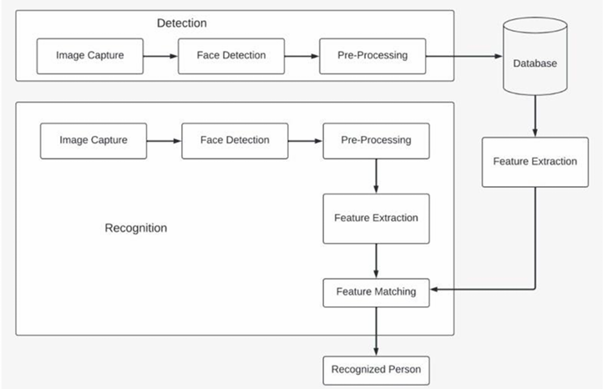
Block Diagram
16

Slide 20
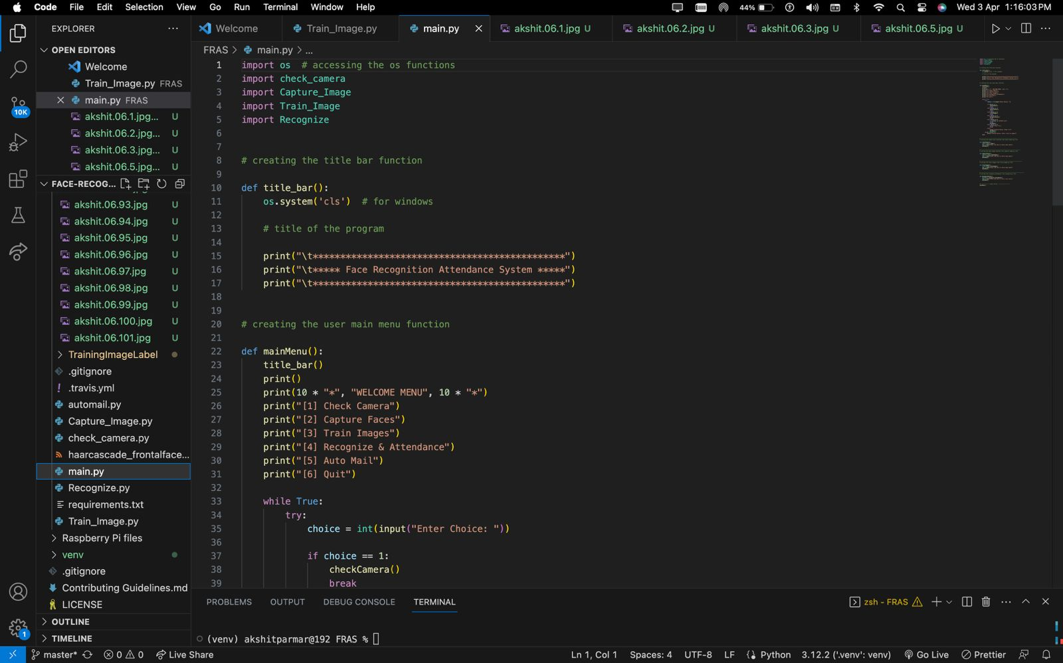
cODE
17

Slide 21
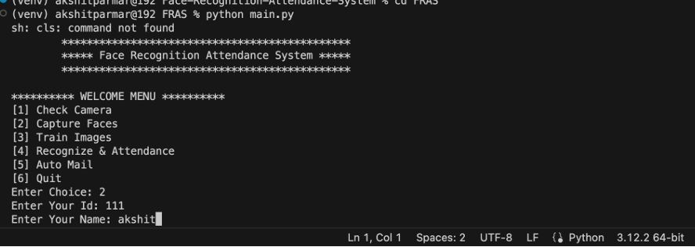
Result

Slide 22
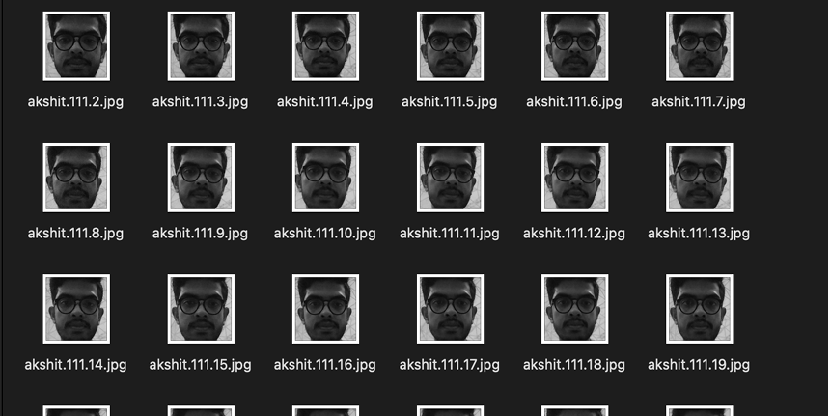
Result

Slide 23
RESULT
Increased accuracy in attendance tracking.
Reduction in administrative workload.
Enhanced security through biometric authentication.
Improved efficiency in attendance management.
Potential for integration with other systems for comprehensive data analysis.

Slide 24
Conclusion
Face recognition attendance systems offer automated, accurate, and secure attendance tracking.
They enhance security, streamline administrative tasks, and promote transparency.
Despite challenges like privacy concerns and technical limitations, ongoing advancements promise improved solutions.
With continuous research and development, face recognition attendance systems are poised for widespread adoption in various sectors.
18

Slide 25
References
[1] Shreyak Sawhney, Karan Kacker, Samyak Jain, Shailendra Narayan Singh , Rakesh Garg, “Real-Time Smart Attendance System using Face Recognition Techniques”, 2020
[2] Naman Gupta, Purushottam Sharma, Vikas Deep, Vinod Kumar Shukla, “Automated Attendance System Using OpenCV”, 2019
[3] Krishna Mridha, Nabhan Tawjih Yousef, “Study and Analysis of Implementing a Smart Attendance Management System Based on Face Recognition Technique using OpenCV and Machine Learning”, 2021
[4] Organization, S. D. I. W. C., Kuster, B. (2018). Face Detection and Face Recognition in Python Programming Language. The Seventh International Conference on Informatics and Applications (ICIA2018).
[5] Emami, Shervin Suciu, Valentin. (2012). Facial Recognition using OpenCV. Journal of Mobile, Embedded and Distributed Systems.
19

Slide 26
References
[6] Yuvaraj, C. Srikanth, M. Kumar, V. Srinivasa Murthy, Y.V. Koolagudi, Shashidhar. (2017). An approach to maintain attendance using image processing techniques. 1-3. 10.1109/IC3.2017.8284353.
[7] Nirmalya Kar, Mrinal Kanti Debbarma, Ashim Saha, and Dwijen Rudra Pal. Study of Implementing Automated Attendance System Using Face Recognition Technique. International Journal of Computer and Communication Engineering, Vol. 1, No. 2, July 2012.
[8] Suma S L, Sarika Raga, “Real Time Face Recognition of Human Faces by using LBPH and Viola Jones Algorithm,” International Journal of Scientific Research in Computer Science and Engineering, Vol.6, Issue.5, pp.6-10, 2018.
[9] A brief history of Facial Recognition, NEC, New Zealand,26 May 2020.[Online]. Available: https:// www.nec.co.nz/market-leadership/publications-media/a-brief-history-of-facialrecognition/
[10] N. Kar, M. K. Debbarma, A. Saha, and D. R. Pal, “Study of Implementing Automated Attendance System Using Face Recognition Technique,” International Journal of Computer and Communication Engineering, vol. 1, no. 2, pp. 100–103, 2012.
20

Slide 27
References
[11] J. Joseph and K. P. Zacharia, “Automatic Attendance Management System Using Face Recognition,” International Journal of Science and Research (IJSR), vol. 2, no. 11, pp. 327–330, 2013.
[12] Naveed Khan Baloch, M. HaroonYousaf, Wagar Ahmad, M. Iran Baig, “Algorithm for Efficient Attendance Management: Face Recognition based Approach”, IJCSI, Vol. 9, Issue 4, No 1,pp.146-150, July 2012.
[13] P. Wagh, R. Thakare, J. Chaudhari, and S. Patil, “Attendance system based on face recognition using eigen face and PCA algorithms,” in 2015 International Conference on Green Computing and Internet of Things (ICGCIoT). IEEE, oct 2015, pp. 303308.
[14] S.-h. Jeng, H. Y. M. Liao, C. C. Han, M. Y. Chern, and Y. T. Liu, “Facial feature detection using geometrical face model: An efficient approach,” Pattern Recognition, vol. 31, no. 3, pp. 273–282, 1998.
[15] Arsenovic, Marko, et al. "FaceTime—Deep learning based face recognition attendance system." 2017 IEEE 15th International Symposium on Intelligent Systems and Informatics (SISY). IEEE, 2017.
21

Slide 28
References
[16] Kar, Nirmalya, et al. "Study of implementing automated attendance system using face recognition technique." International Journal of computer and communication engineering 1.2 (2012): 100.
[17] Yuvaraj, C. Srikanth, M. Kumar, V. Srinivasa Murthy, Y.V. Koolagudi, Shashidhar. (2017). An approach to maintain attendance using image processing techniques. 1-3. 10.1109/IC3.2017.8284353.
22

Slide 29
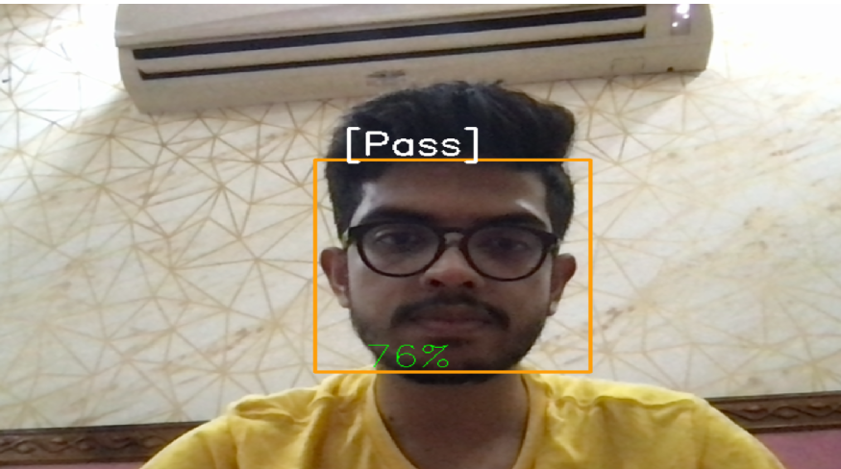

Slide 30
